Slide 1


Optimal Route Analayzer
Presenting to :
Dr Amit Verma

Slide 2

The Economic impact of the 2020 coronavirus pandemic in India has been largely disruptive. India's growth in the fourth quarter of the fiscal year 2020 went down to 3.1% according to the Ministry of Statistics.
The revised Gross Domestic Product (GDP)
estimates for India downwards by 0.2 %
Points for the fiscal year 2020 to 4.8 %
and by 0.5 % for the fiscal year 2021 to 6 %.
The Indian economy was expected to lose over
₹32,000 crore (US$4.5 billion) every day
during the first 21-days of complete
Lockdown.

Slide 3

While the country is facing an economic slowdown, India’s travel and tourism industry is showing hardly any signs of retreat.
Travel and Tourism Sector Likely to Lose 5 Rs lakh Crore Due to Covid – 19 Crisis.
The market is set to touch a staggering $9 billion market size by 2025, bolstered by an influx of new-age travel start-ups, and changing trends driven by Travel Agencies

Slide 4

Optimal Analyser and Feasible Solution
After all this is Over the People Must be Very Eager to Come Outside Since a Very Long Time of Stay.
They just wanted to escape their mundane lives and give them a different beat.
They will be Interested in services and products to help them stay safe and healthy even at extra money
Days are Finally Changing
Time to Fly Again

Slide 5

What’s Gonna Effect ?
Since Due to Pandemic major of the Industries or Companies are in Deprivation .
From healthcare to education, Every market segment is witnessing the impacts of technological Disruption.
Then why not the Travel and Tourism sector, which is plagued by the ghosts of budgeting and time constraints ? As they see steps towards them they try to profitize themselves , by swindling the customers.

Slide 6

These are hard times for travellers. They are also pretty tough for those just beginning with a view to getting started in the travel industry.
Why go to your local agency to ask questions about some faraway destination when Google can answer those for you ?
Why rely on a third party agency when we can, through the internet, find the accommodation or service that you’re looking for and book directly ?
Any why remain loyal to a particular agent when there are thousands at your fingertips ?

Slide 7

However, Nowadays Travellers aren’t naïve when it comes to pricing their trip. They’re sensible enough to shop around and find the best deal, and they certainly won’t be fooled into paying over the odds when they know how many potential options there are available for them.
Optimal Analyser and Feasible Solution
Let’s Break Bonds With the Fake Agencies
With more holiday bargains on the internet than you can imagine, along with a host of small agencies and big hitters buying the attention of potential travellers, loyalty is a rare thing in today’s market

Slide 8

What We Gonna Do Now ?
Let us See What do we have to Overcome This Problem!

Slide 9


~ In this research we used method of Kruskal Algorithm using the concept of Travelling Salesman Problem (TSP) to determine the regular service routs that minimizes the travelling costs.
The cities will be sorted out in such a way that it does not form a cycle.~
Objective : - “The primary objective of this project is to find the shortest possible route that visits the city in a limited amount of time in C programming language.
“
Sub Objectives :
The System should not be able to :
Identify allocations of clients on a map.
Designing algorithm for Optimal Route Analyzer.
Output the least time visit.
~ The simplest solution is to try all the possibilities, but this is also the most Time Consuming.
Not only It focus on finding the most effective route, Our Research is often concerned with finding the cheapest solution.~
~ The large amount of variables creates a challenge when finding the shortest route, which makes approximate, fast and cheap solutions all the more attractive.

Slide 10
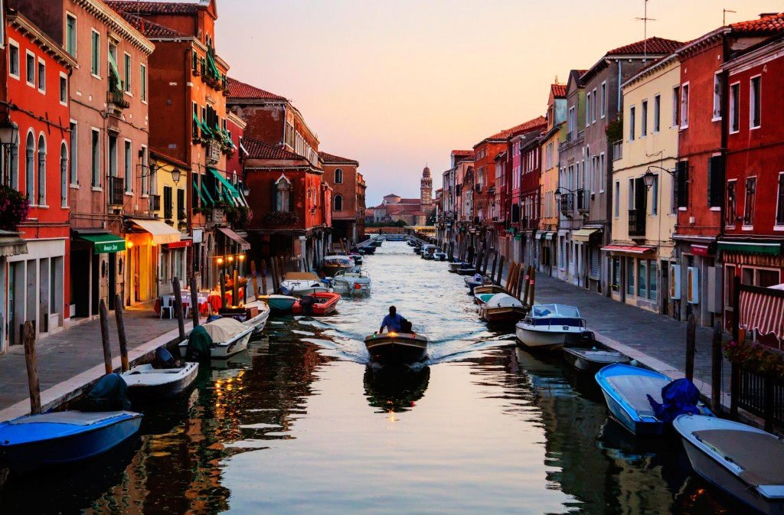
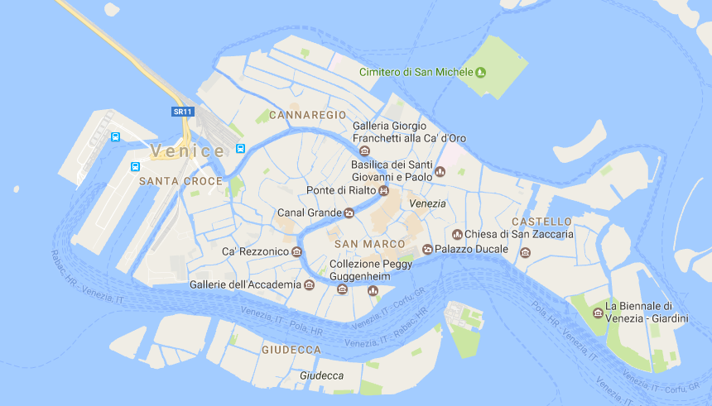
On my trip to Venice ,I plan to visit all the important Heritage sites but am short in time. To make our itinerary work, we can decide to use our Algorithm .
Here is a map of Venice.
Let’s Simplify the map by converting it into a graph and name the important locations on the map with letters and distance in meters (x 100).

Slide 11

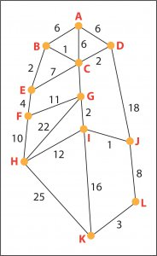
Methodology:
Cannaregio | Ponte Scalzi | Santa Corce | Dell ‘Orto | Ferrovia | Piazzale Roma | San Polo | Dorso Duro | San Marco | St. Mark Basilica | Castello | Arsenale
A | B | C | D | E | F | G | H | I | J | K | L
~ Let’s understand how our algorithm works in the real world example using the above map.
Step 1- Remove all the parallel edges.
~ So for the given map, we have a parallel edge running between Madonna Dell’ Orto (D) to St. Mark Basilica (J), which is of length say 2.4kms(2400mts).
~ We will remove the parallel road and keep the 1.8km (1800m) length for representation.
~ Here , the Weights on the Edge represent the Distance Between the Cities.

Slide 12
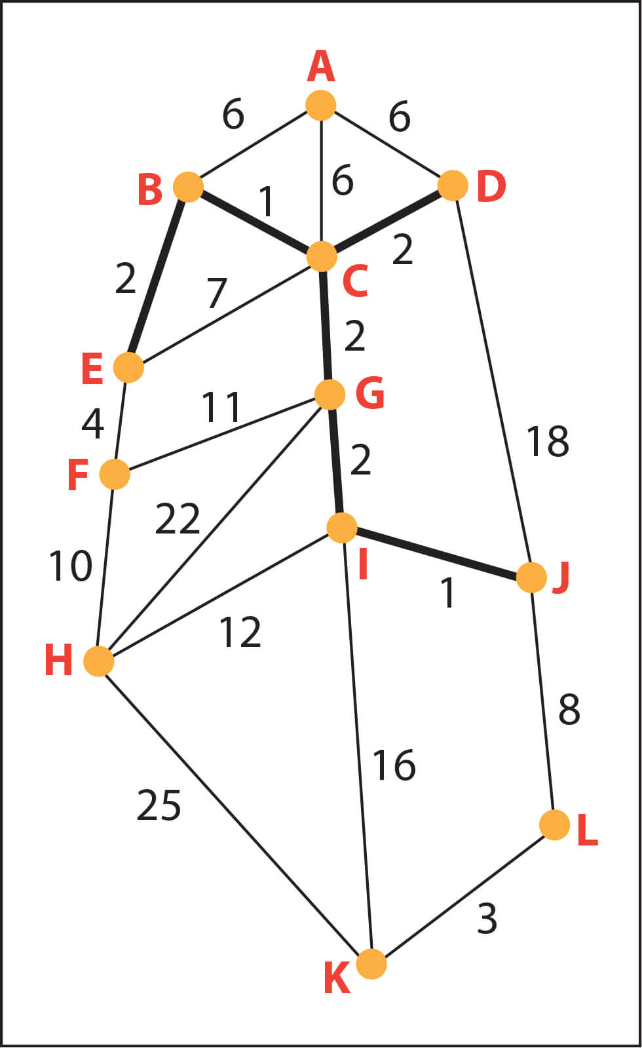

Step 2 – Arrange all the edges on the graph in ascending order. Algorithm considers each group as a tree and applies disjoint sets to check how many of the vertices are part of other trees.
B,C | I,J | B,E | C,G | G,J | C,D | K,L | E,F | A,B | A,C | A,D | E,C | J,L | F,H | F,G | H,I | I,K | D,J | G,H | H,K
1 | 1 | 2 | 2 | 2 | 2 | 3 | 4 | 6 | 6 | 6 | 7 | 8 | 10 | 11 | 12 | 16 | 18 | 22 | 25
Step 3 – Add edges with least weight; we begin with the edges with least weight/cost. Hence, B, C is connected first considering their edge cost only 1.
~ I,J & B,C has cost 1; it is the edge connected next.
~ Then, we connect edges with weight = 2.
~ Similarly, we connect all the nodes one by one mountingly acc. To their weights

Slide 13
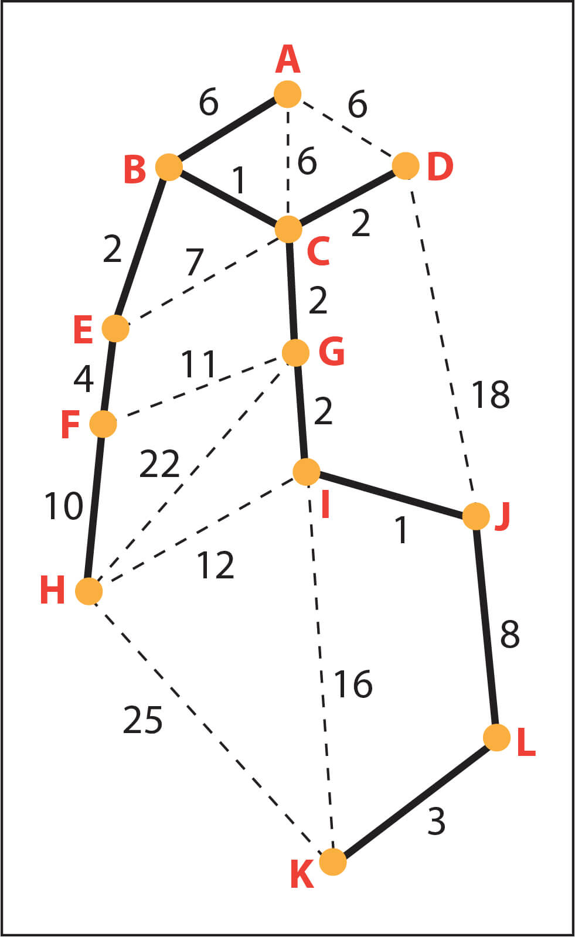


As given in the table above (Pg – 10), all the edges are connected in ascending order, ensuring no loop or cycle is formed between 2 vertices.
This gives us the following graph,
Kruskal helps us build a tree which connects all nodes, or as in the case above, all the places/cities in limited amount of time by not forming a cycle.
Whereas, Traveling salesman problem (TSP) makes you to visit all the places with minimum total weight by applying best of all the possibilities.

Slide 14
Operation Analyzer & Feasible Solution
Algorithm
~ Start
~ Create an Array of Size we want ( Defined )
~ Initializing ( n ) as the number of user inputs to store no. of cities ( nodes )
~ Initializing ( c ) and (c1) as a counter variable.
~ Enter the number of cities along with the name.
~ Displaying all the total possible routes covering all cities.
~ Filtering of routes is done for the Ease
~ Displaying the total possible combinations that formed.
~ Now, Taking the input from the user to enter the distance between the cities which displayed as weights and store it into the array data.
~ Now , The Process Starts for finding the Minimum route Comparing each Nodes and Select it.
~ Displaying Node-pair along with unique id and data to give the Sorted view of the Procedure Followed.
~ Display Which Route to Select as a Shortest Path.
~ End

Slide 15
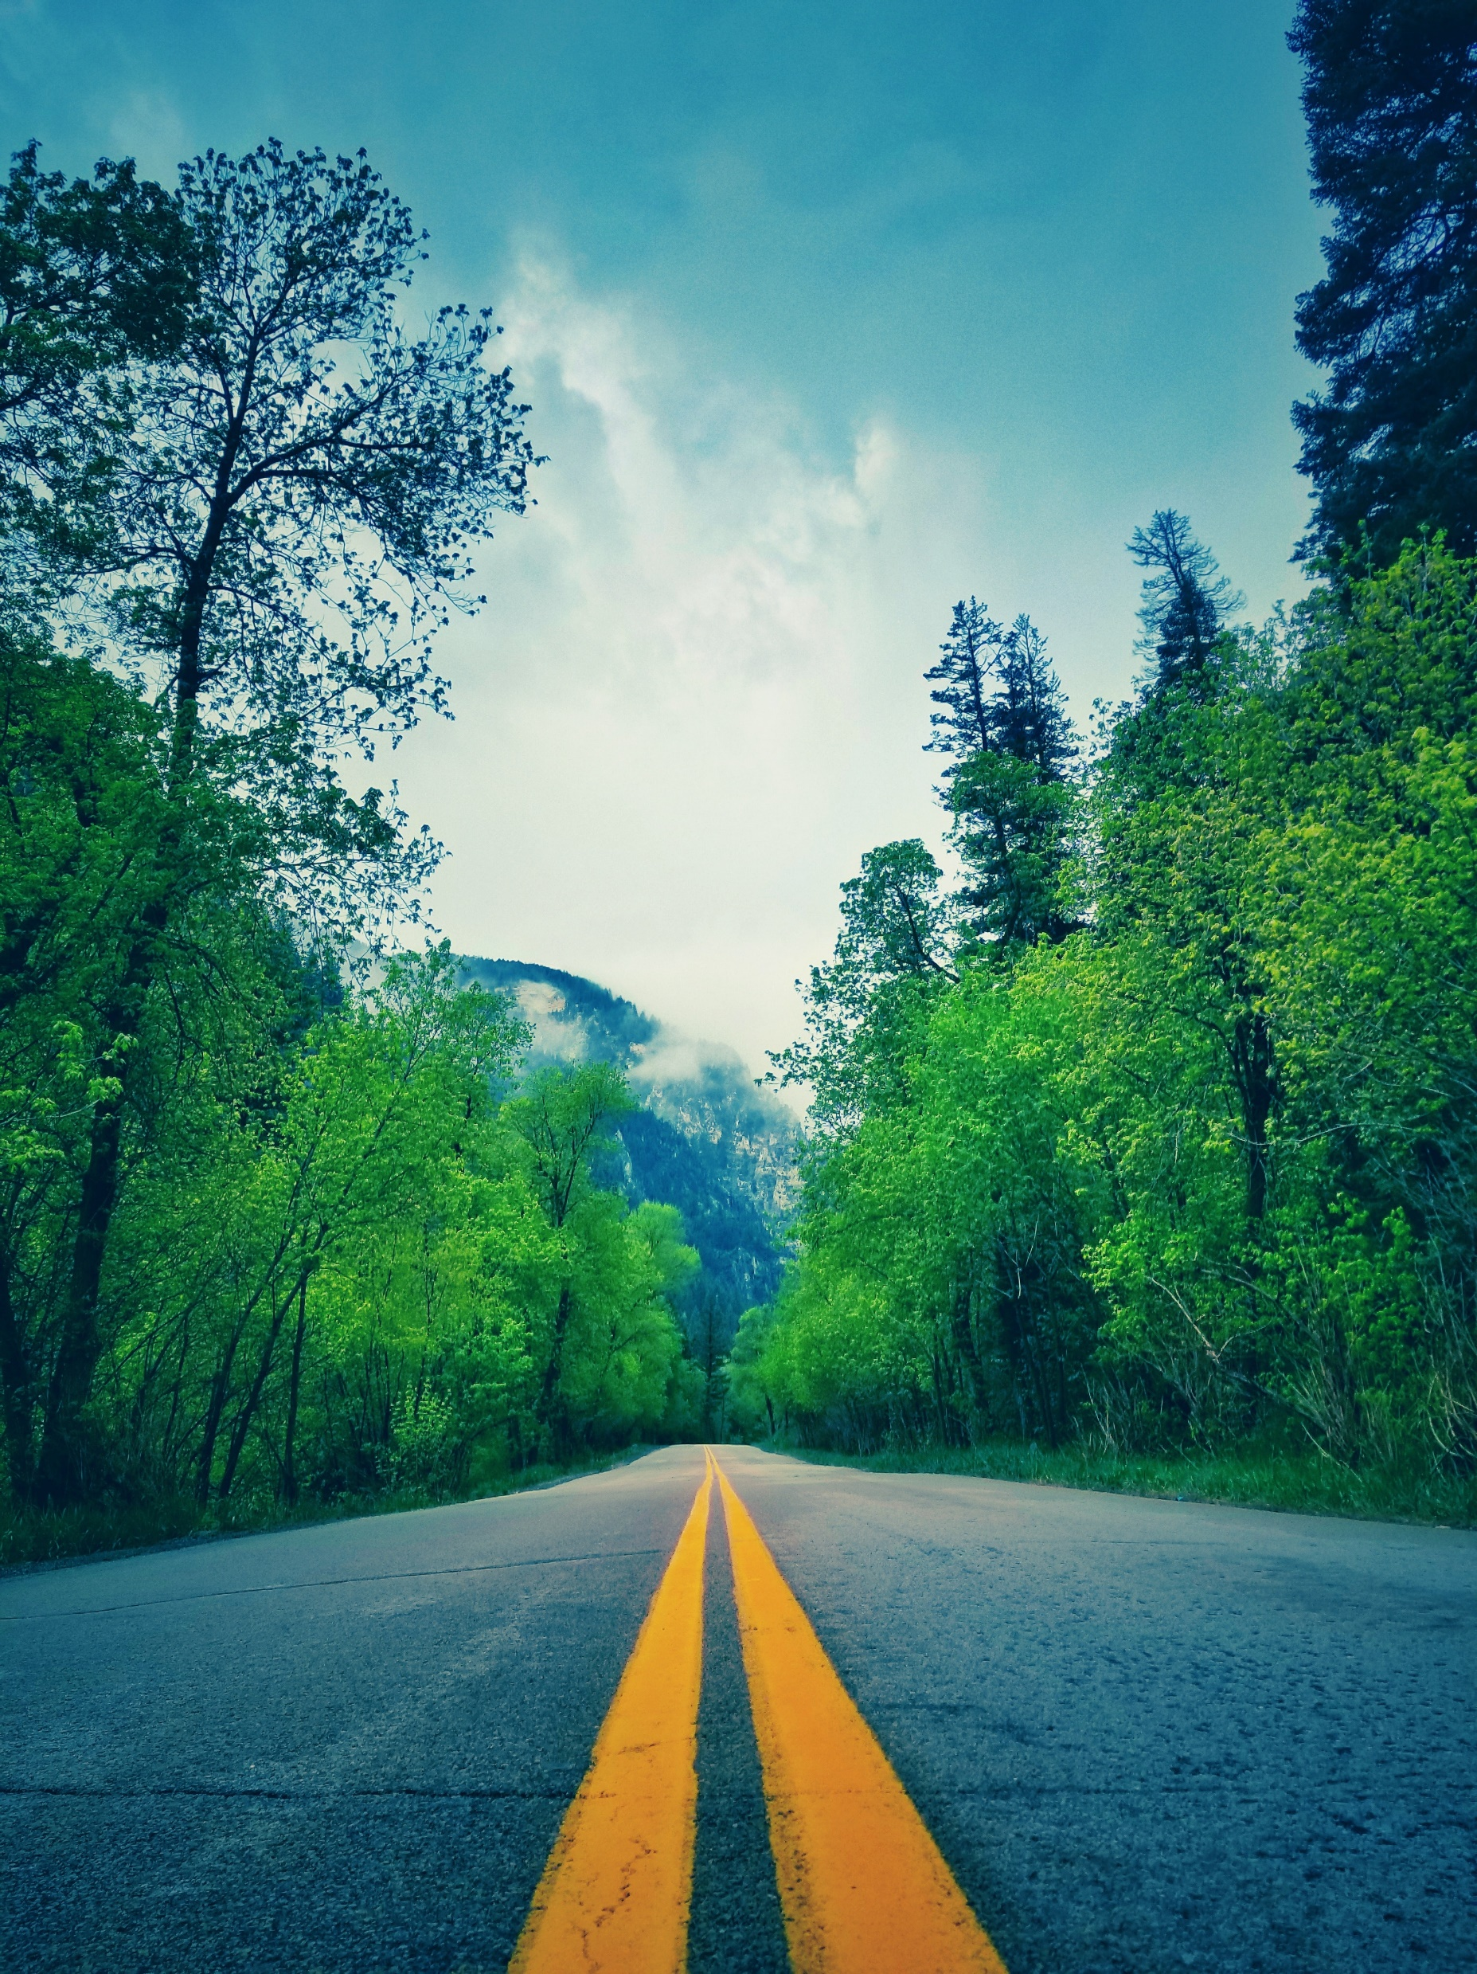

Conclusion : -
This Project focus on the Algorithm of achieving the Shortest Path.
It draws the idea of the minimum spanning tree algorithm , and gives the work-flow push system based on TSP algorithm.
Through the example analysis, in which cities are selected randomly as initial population, It is concluded that this selection path of algorithm is more accurate, stable, focused on Optimization and has the Advantage of time that gives us better Solution often means a Solution that is Cheaper, Shorter, or Faster

Slide 16
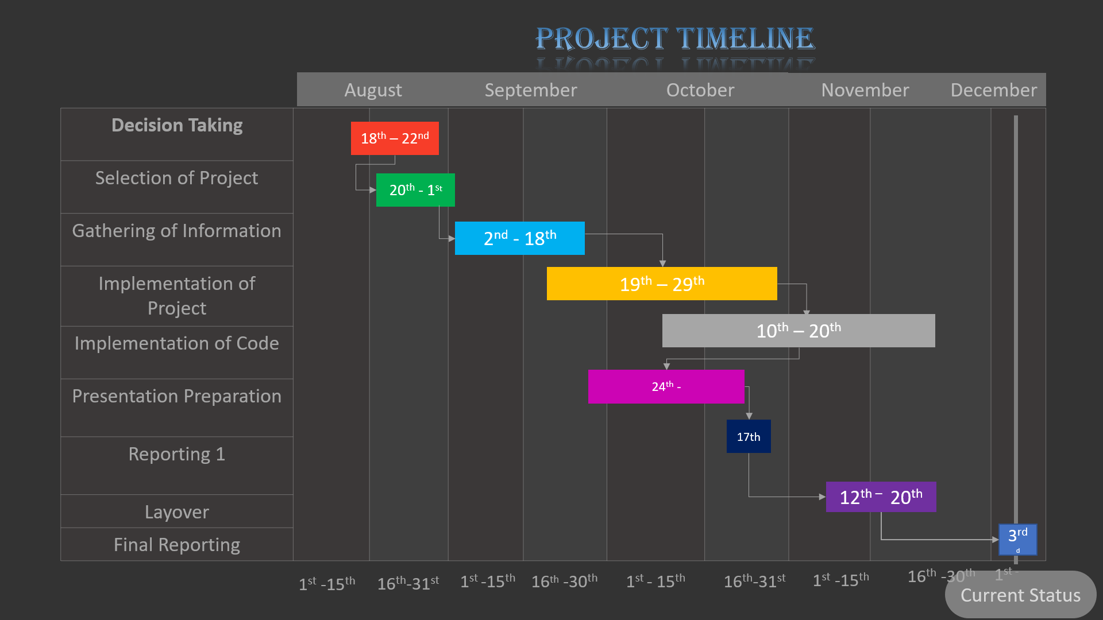
Project Timeline
January
February
March
Decision Taking
Selection of Project
Gathering of Information
Implementation of Project
Implementation of Code
Model the Project
Presentation Preparation
Reporting
8th – 14th
13th - 16th
16th - 24th
Started
Pending
Pending
N/A
N/A
1st -10th
11th -20th
21th -31st
1st -10th
11th - 20th
21st -30th
1st -10th
11th -20th
21st -31st
Current Status

Slide 17

References : -
[1] Damitha Bandara - Assistant Professor of Supply Chain Management Albany State University, Albany, GA. USA College of Business ; Operation analyzing and Application on the travelling Salesman Problem. (https://airccse.com/oraj/papers/4417oraj02.pdf)
[2] Margaret Rouse - IT professionals at Whalts.comTechnical Writer and Director, WhatIs.com — TechTarget United States , application of Kruskal algorithm problem. (https://www.techtarget.com/contributor/Margaret-Rouse)
[3] Arpit Mishra - Empowering developers at HackerEarth , Implementation of Kruskal problem and TSP together with real life examples. (https://www.hackerearth.com/blog/developers/kruskals-minimum-spanning-tree-algorithm-example/)
[4] Frederick M. Dandure ,“National University of Science and Technology ” (https://www.researchgate.net/publication/333672845_Route_Planning_using_The_Kruskal's_Algorithm_A_Case_of_Lobels_Bulawayo)
[5] Whitsett, D., (2017). Process Flow: Charts , Diagram and Development. Available at:
https://study.com/academy/lesson/scrum-process-ﬂow-diagram-development.html

Slide 18




THANK YOU
Mentor
Mr. Sudhanshu Srivastava
(+91) 7017317873
aksharma@ddn.upes.ac.in

